Slide 1
Final Cooling with Thick Wedges for a Muon Collider
Bachelor’s Thesis Progress Report, 3/5/2025
Daniel Fu
Faculty Advisor: Dr. Karri DiPetrillo

Slide 2
Introduction: Muon Collider
A muon collider presents significant advantages for high-energy collider research over conventional proton or electron colliders
Muons are elementary particles → whole energy of collision used in interaction
Muons are more massive than electrons → synchrotron radiation losses minimal
As a lepton collider, it can perform precision measurements
Potential to explore new physics (at the 10 TeV+ scale) in a smaller footprint and lower cost

Slide 3
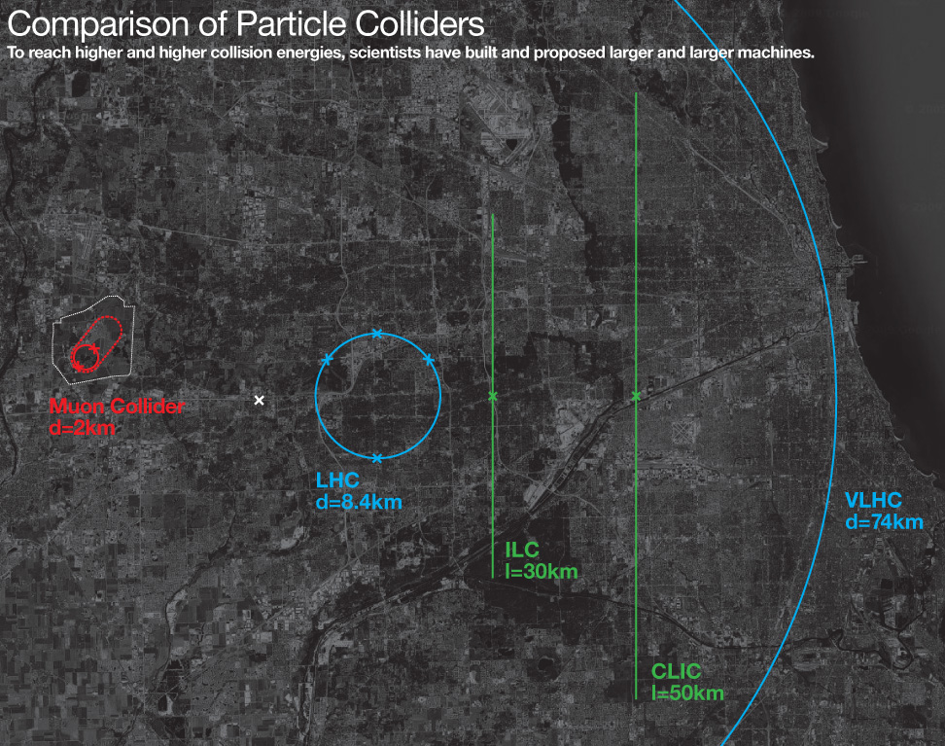

Slide 4
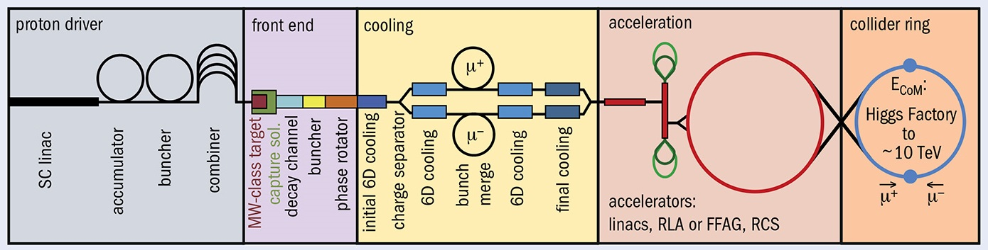
Introduction: Cooling
Major challenge: emittance (position/momentum spread) of muons must be reduced prior to acceleration (cooling)
In the final cooling step, transverse emittance is reduced while longitudinal emittance is allowed to grow (emittance exchange)
Exploring a wedge-based method for achieving emittance exchange

Slide 5
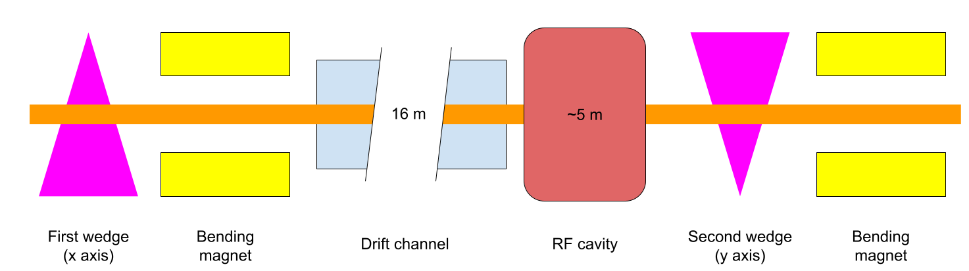
Muon cooling channel
In 2023, I modelled the wedge and RF cavity in G4Beamline
In 2024, Ryan Michaud modelled the drift channel in MAD-X

Slide 6
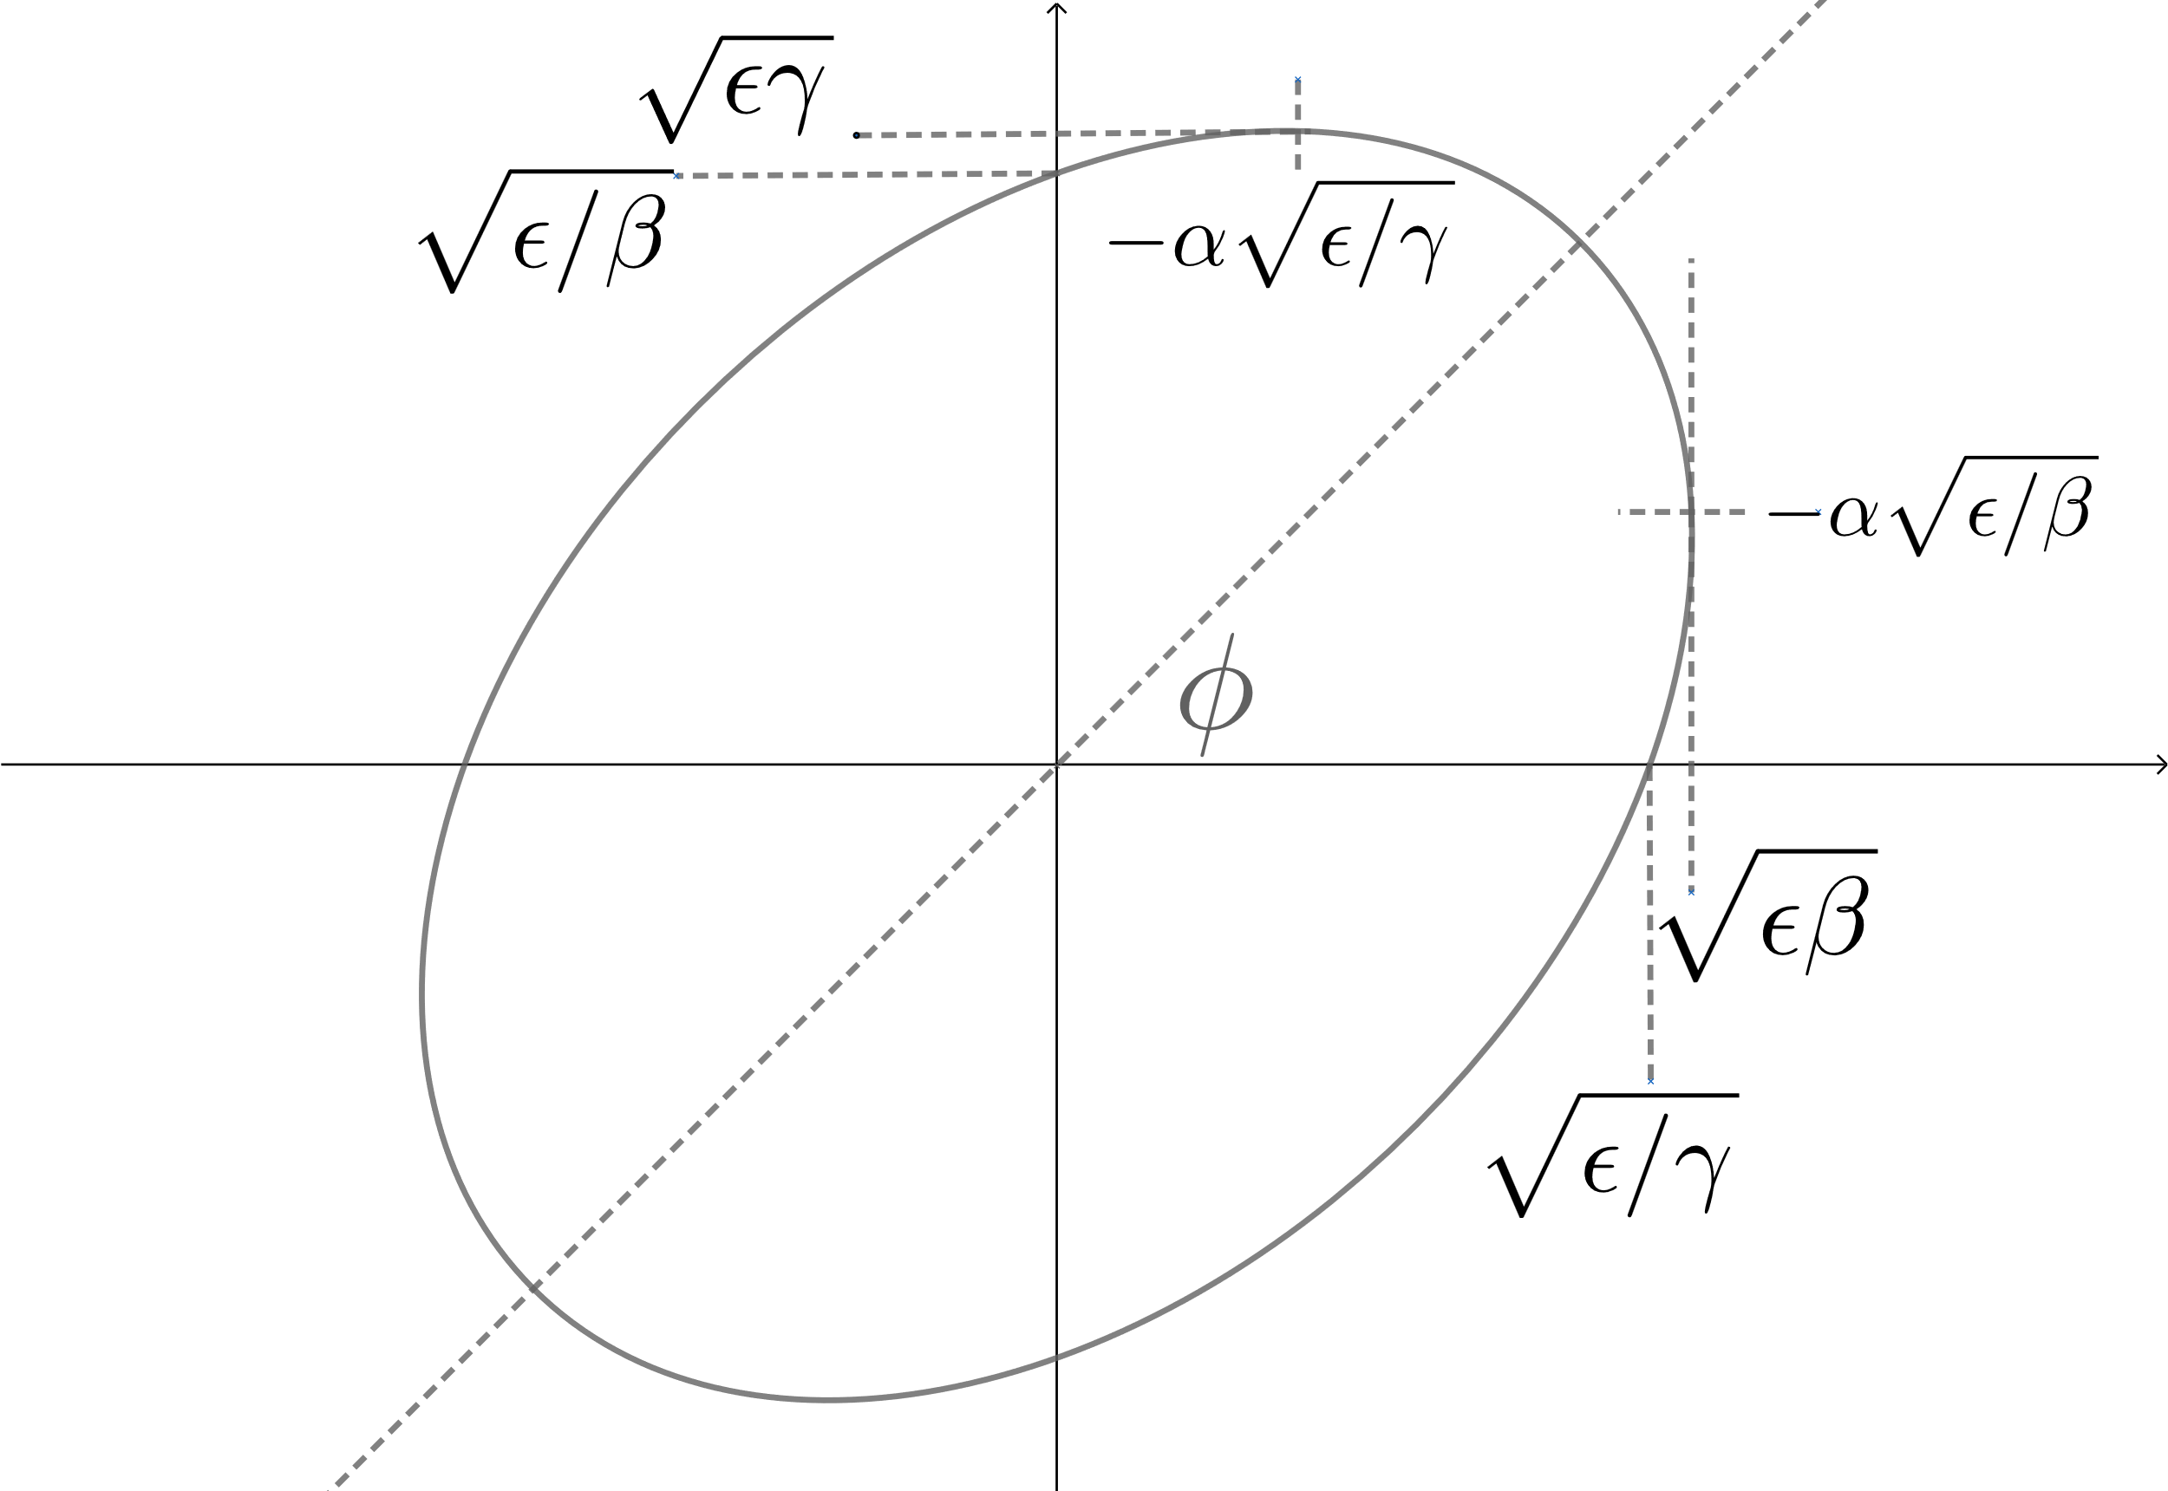
Background: Emittance and Courant–Snyder parameters
Describe particle distribution in position-momentum (phase) space
Emittance measures the size of the distribution
β (beta) measures the physical size of the beam
α (alpha) indicates whether the beam is converging or diverging
Measured on each axis
Also known as Twiss parameters

Slide 7
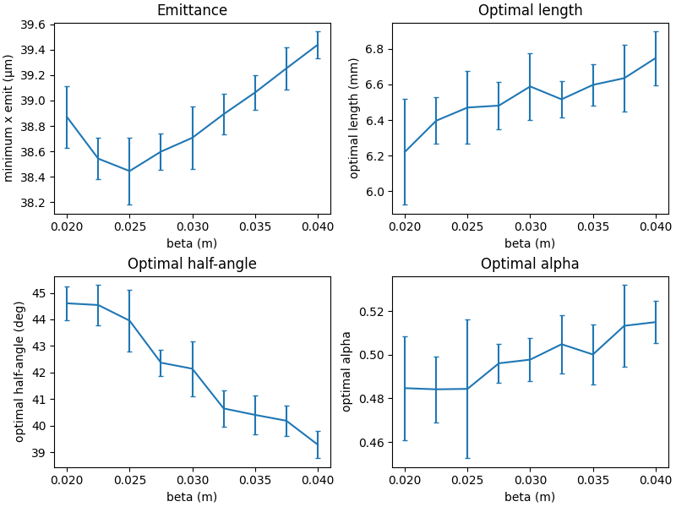
Additional Wedge Simulations
Performed simulations to characterize effect of beta and alpha on wedge performance
Varied beta while optimizing wedge length, wedge half-angle, and beam alpha at each point
Repeated trials to account for stochastic effects
Minimum emittance attained at beta of around 0.025 mm

Slide 8
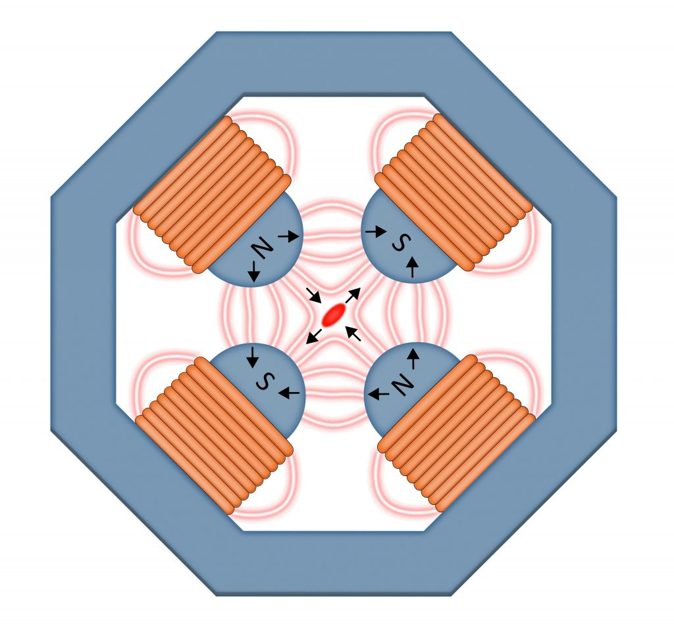
Drift channel
Transports beam to allow faster muons to outpace slower muons
Quadrupoles focus beam in one axis and defocus in another
Alternating quadrupoles achieve focusing in both axes
Called a FODO (focus-open-defocus-open) array
Each repeating cell should be periodic
Diagram of a quadrupole magnet
Model of a FODO array
Beam converging in x, diverging in y
Beam diverging in x, converging in y

Slide 9
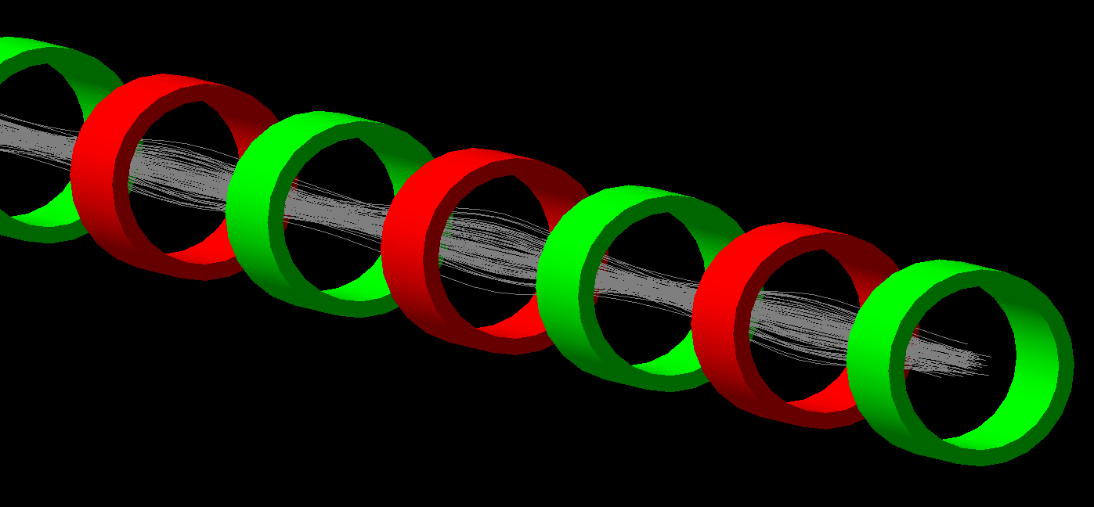
Drift channel

Slide 10
Differences between MAD-X and G4Beamline
G4Beamline
MAD-X
Tracks single particles
Considers momentum spread
Simulates magnetic fields in detail
Not easy to perform optimization
Magnet strength measured in B field gradients
Tracks distributions of particles
Only beta/alpha considered
Makes approximations for magnets
Fast optimization for magnets
Magnet strength described by quadrupole coefficient

Slide 11
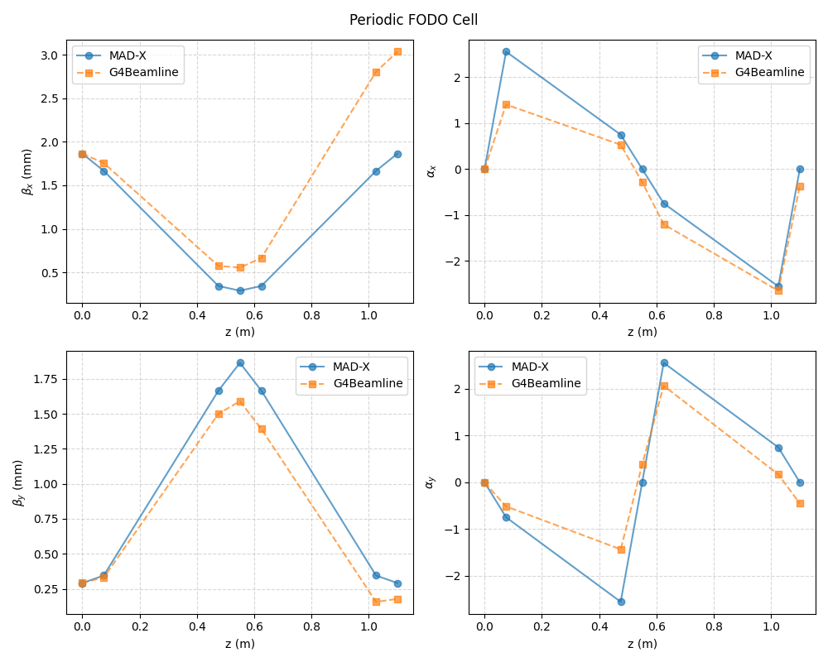
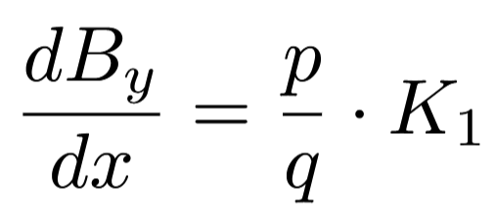
Drift channel in G4Beamline
Translated design of periodic FODO cell from MAD-X to G4Beamline
Converted quadrupole coefficients to B field gradients
Found discrepancies between MAD-X and G4Beamline results

Slide 12
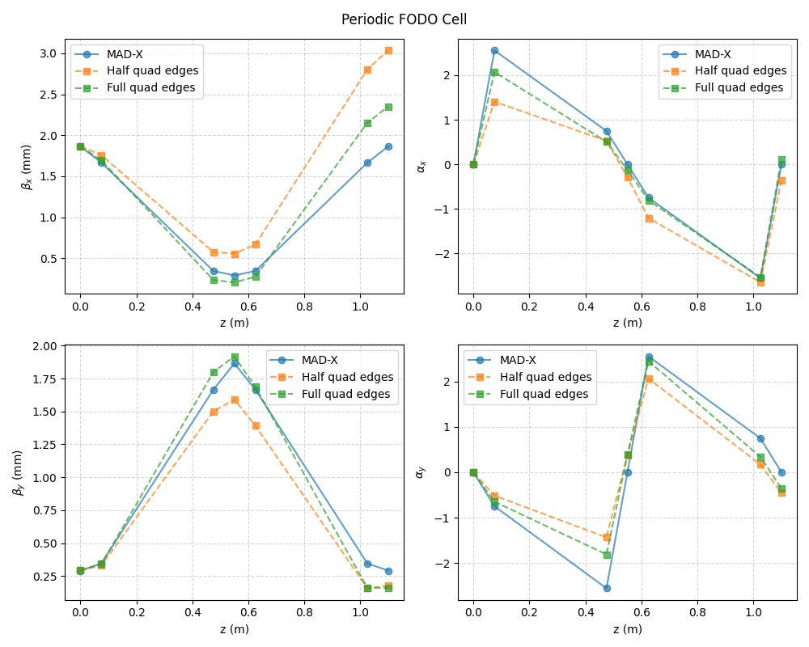
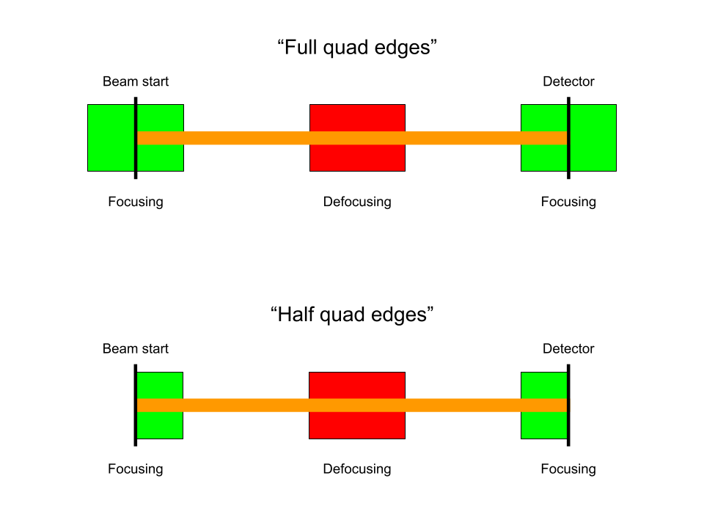
FODO cell edges
In MAD-X, FODO cell has half a focusing quad at the start and end
MAD-X does not account for fringe fields, but G4Beamline does
Using full edge quads in G4Beamline produced better results
However, models still do not match
Layout of model in MAD-X (left) v.s. G4Beamline (right)

Slide 13
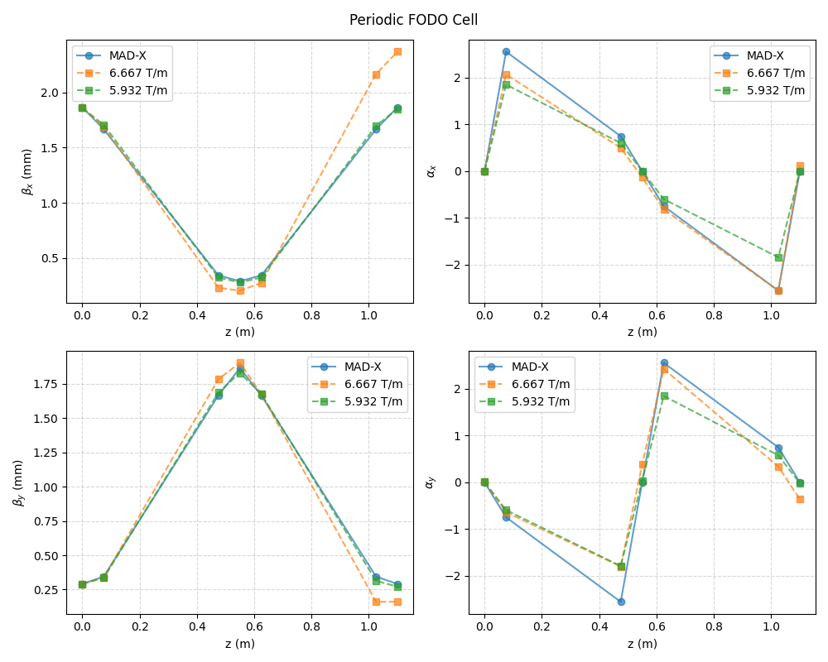
Optimizing Magnet Gradients
Ran optimization to minimize difference in beta in G4Beamline
Found a slightly lower magnetic field gradient than in MAD-X (5.932 T/m vs. 6.667 T/m)
Beta curves match closely but alpha curves differ at some points
Unsure why this difference exists

Slide 14
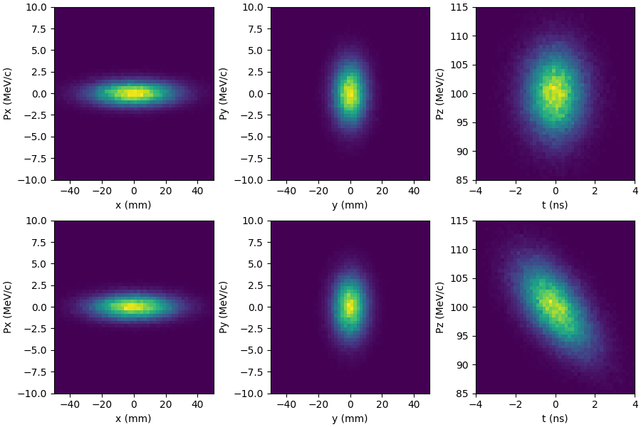
Simulation of multiple cells
Before drift
After drift

Slide 15
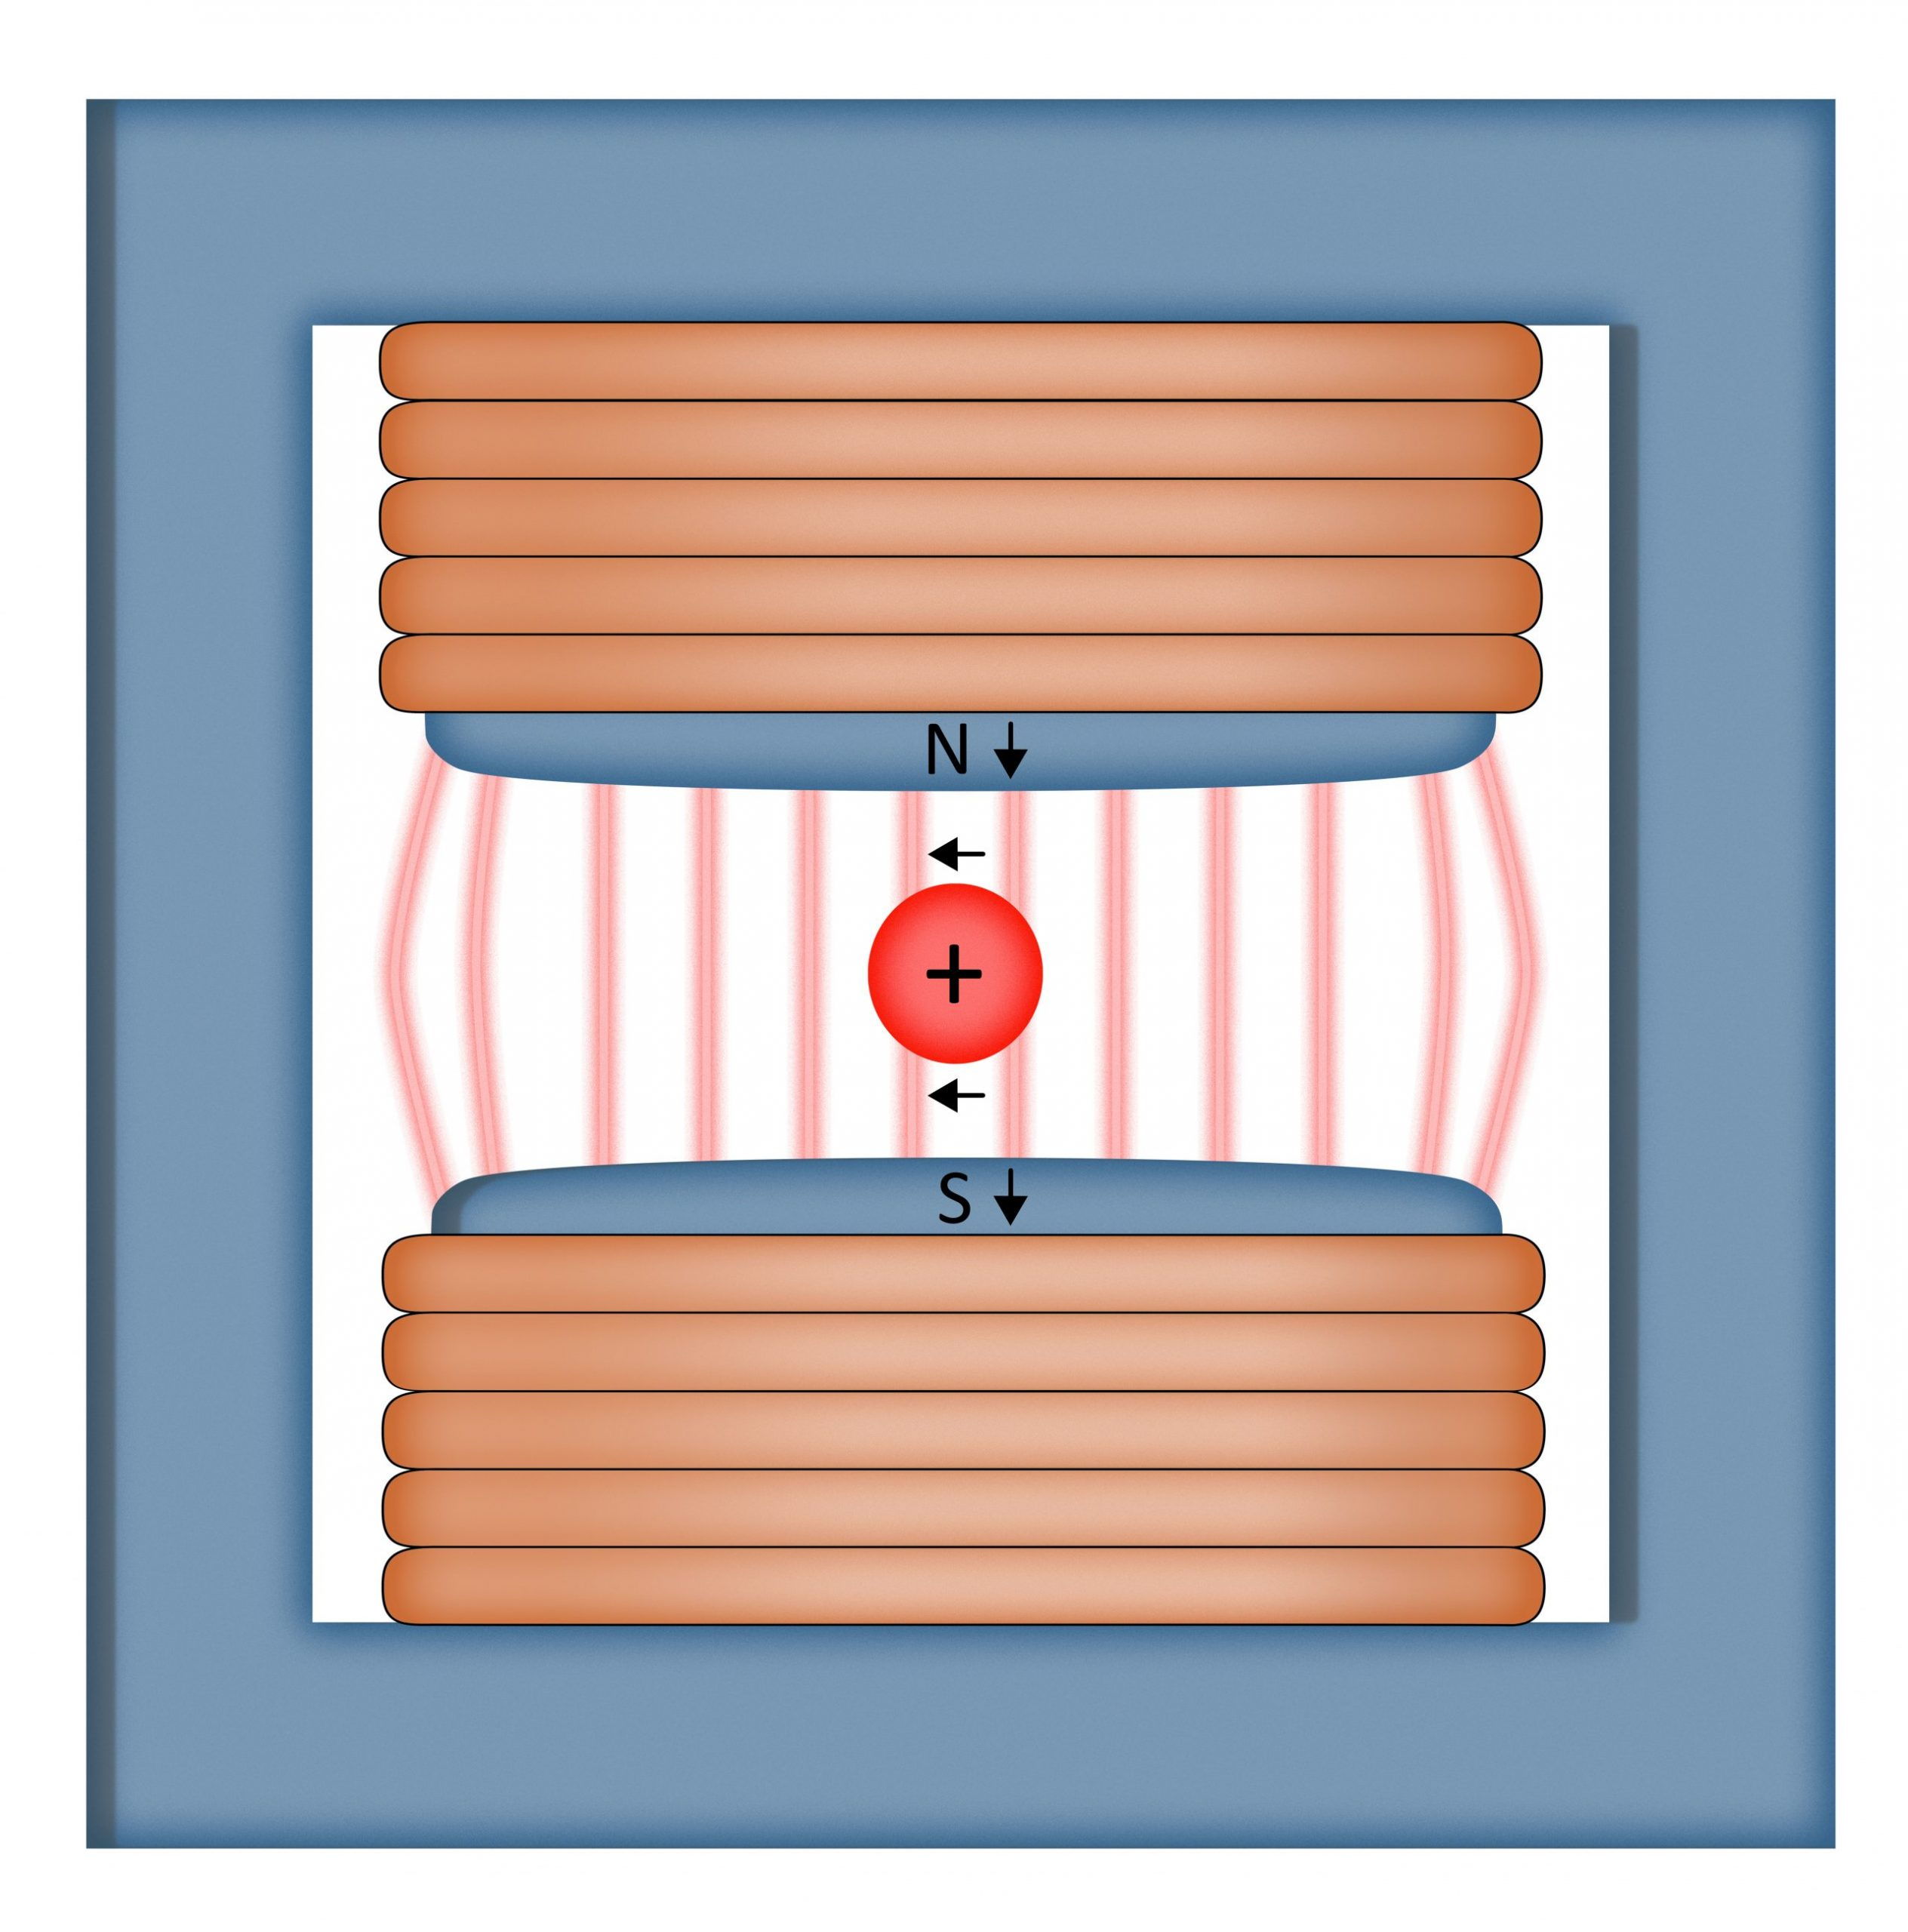
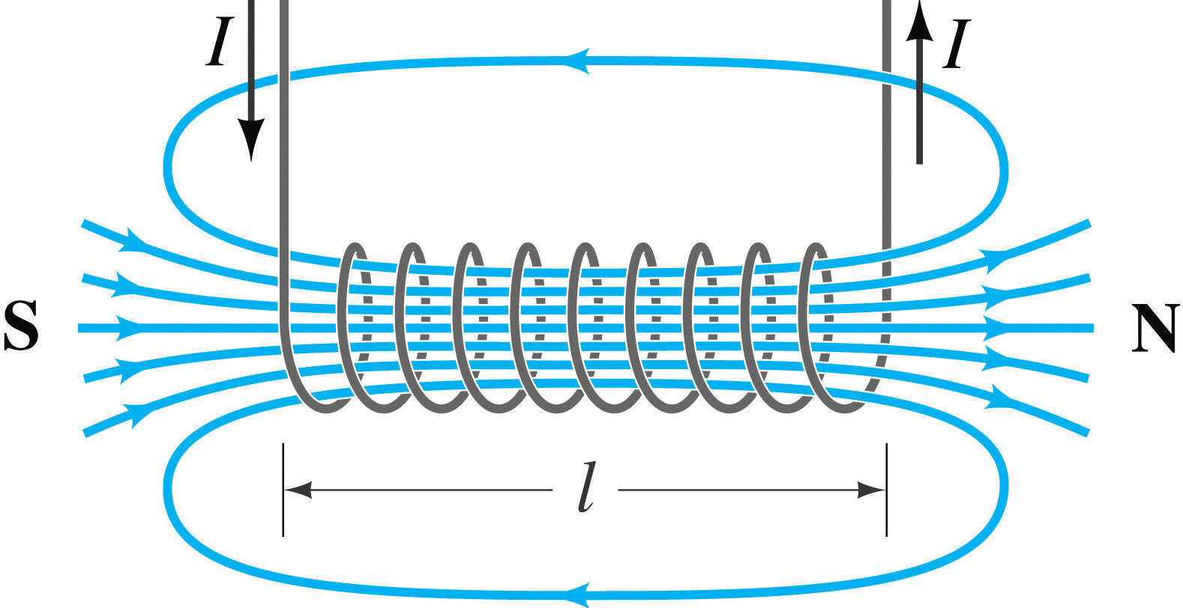
Next Steps
Continue investigating discrepancy between MAD-X and G4Beamline
Model magnet assembly around wedge (likely solenoid)
Model bending magnets (dipole)
(If time permits) model quadrupoles around RF cavity(s)
Left: Diagram of a dipole magnet Right: Magnetic field of a solenoid

Slide 16
Thank you for listening!
Questions?

Slide 17
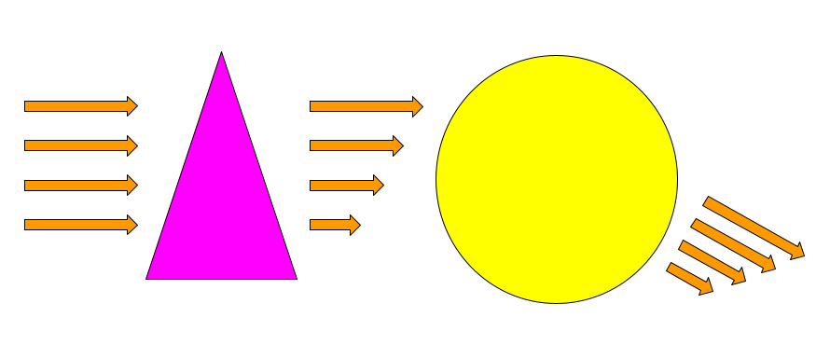
Wedge mechanism
2. Muons encounter varying amounts of wedge material, thus decelerate by different amounts
3. Bending magnet deflects particles by amount proportional to momentum
1. Beam enters wedge absorber
4. Resulting beam has lower transverse emittance but higher spread in longitudinal momentum

Slide 18
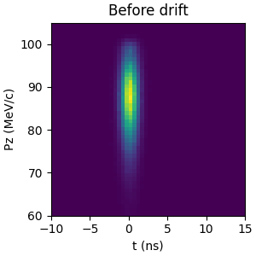
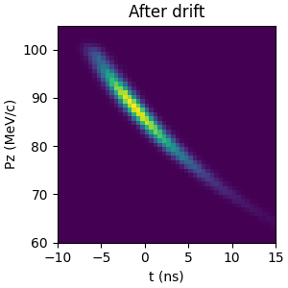
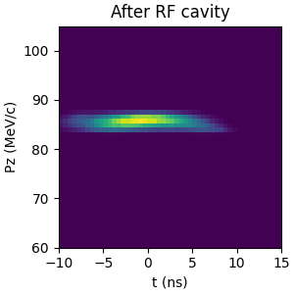
Phase Rotation Mechanism
Particles travel through drift channel – correlation between z and Pz
RF cavity applies time-varying E-field – decelerates faster muons and accelerates slower muons
Decreases longitudinal momentum spread at the cost of increasing longitudinal position spread (longitudinal emittance unchanged)

